Slide 1

Evaluation of Blockchain
From 1.0 to 3.0
ECLT5820 – Group 1
Lin Youguang | 1155169171
Li Jialang | 1155160950
Kong Fan Nap | 1155152768

Slide 2
1
Introduction of Blockchain
2
Blockchain 1.0
3
Demonstration of 1.0
4
Block chain 2.0
Contents
5
Demonstration of 2.0
6
Blockchain 3.0

Slide 3
1
Introduction of Blockchain

Slide 4

Definition
a shared, immutable ledger
process of recording transactions
tracking assets in a business network. - Tangible asset: a house, car, cash, land) or - Intangible asset: intellectual property, patents, copyrights, branding
Anything of value can be tracked and traded on a blockchain network

Slide 5
Characteristics of Blockchain
Decentralized. The basic feature of blockchain do not rely on centralized node the data record, store and update distributed
Transparent. The data record is transparent to each node also transparent on update the data, therefore blockchain is trustworthy
Open Source. the novel blockchain system open to everyone (Ethereum, Cosmos, Cardano) record can be checked publicly, public can create application on it, enhance the variety of application

Slide 6
Characteristics of Blockchain
Autonomy base on consensus, every node transfer safely the idea is to trust from single person to the whole system no single one can intervene it
Immutable Records will be reserved, cannot changed unless take control of < 51% node
Anonymity solved the trust problem between node to node data transfer and transaction can be anonymous only need to know blockchain address

Slide 7


选题内容
Proof of Work (PoW)
network participants spend time to solving an arbitrary mathematical puzzle
very low probability of successful generation
unpredictable which node will be able to generate the next block
widely used in cryptocurrency mining
peer-to-peer transactions securely without a trusted third party
Introduction
Introduction
Blockchain 1.0
Demonstration of 1.0
Blockchain 2.0
Demonstration of 2.0
Blockchain 3.0
Proof of Stake (PoS)
an election process: one node is randomly chosen as a validator: mint or forge new blocks.
To become a validator, deposit a certain amount of coins to the network as a stake
Validator ordering transactions and creating new blocks
All nodes agree on the state of the network
*

Slide 8
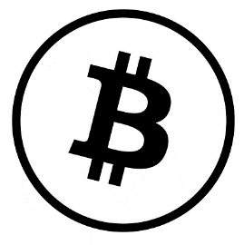
Blockchain 1.0 Application
In 2008, Satoshi Nakamoto introduced the first application : Bitcoin
Consensus: Proof of work, SHA-256 hashing function validate transactions & issue new bitcoins
Mining: blocks are created in about 10 minutes each solvers of the computation challenges are rewarded currency
POW algorithm take a lot of computing power - Costly, Time consuming, Energy consuming - Business insider: Bitcoin mining 0.5% of all energy consumption worldwide, - Annual electricity use than all of Finland, a country of 5.5 million ppl
Introduction
Blockchain 1.0
Demonstration of 1
Blockchain 2.0
Demonstration of 2.0
Blockchain 3.0
Blockchain 1.0
*

Slide 9
improvement of Blochain2.0
Introduction
Blockchain 1.0
Demonstration of 1.0
Blockchain 2.0
Demonstration of 2.0
Blockchain 3.0
Smart contract
Make blockchain programmable
Blockchain2.0
PoS
Save computational power
Blockchain 2.0
Ghost Protocol
Guarantee higher TPS
*
Notes:
Let us talk about the improvment of blockchain2.0
1.Blockchain 2 inrtrouce smart contract and we will talk about it later.
2.Secondly , Proof of stake is gradually replacing Proof of work to become the concensus mechanism.It saves computation power and it is envonmentally friendly.
3.Blockchain uses the Ghost protocol as soon as possible to initiate a forked block to facilitate a unified blockchain, and therefore guarantee higher efficiency.

Slide 10
Blockchain1.0 vs Blockchain2.0
Introduction
Blockchain 1.0
Demonstration of 1.0
Blockchain 2.0
Demonstration of 2.0
Blockchain 3.0
 | Blockchain1.0 | Blockchain2.0
Type of State | Only two(Successful/Unsuccessful) | Multiple State
Block Time | Long (in minutes) | Short (in seconds)
TPS | 3.3 - 7 | 15
Programmable | No | Yes
Consensus mechanism | PoW | PoW + PoS
Application | Bitcoin | Defi,Dapp,NFT
Final goal | Digital gold | Financial OS
Blockchain 2.0
*
Notes:
Compare with blockchain1.0 , blockchain2.0 have more states, providing more flexiblity so that it can deal with more complex business logic. And it has shorter blocktime and higher TPS, providing higher efficiency. Small contracts can be run over blockchain2.0 and PoS is supported. It has a wider range of applications including Decentralize finance, decentralize app and NFT.

Slide 11
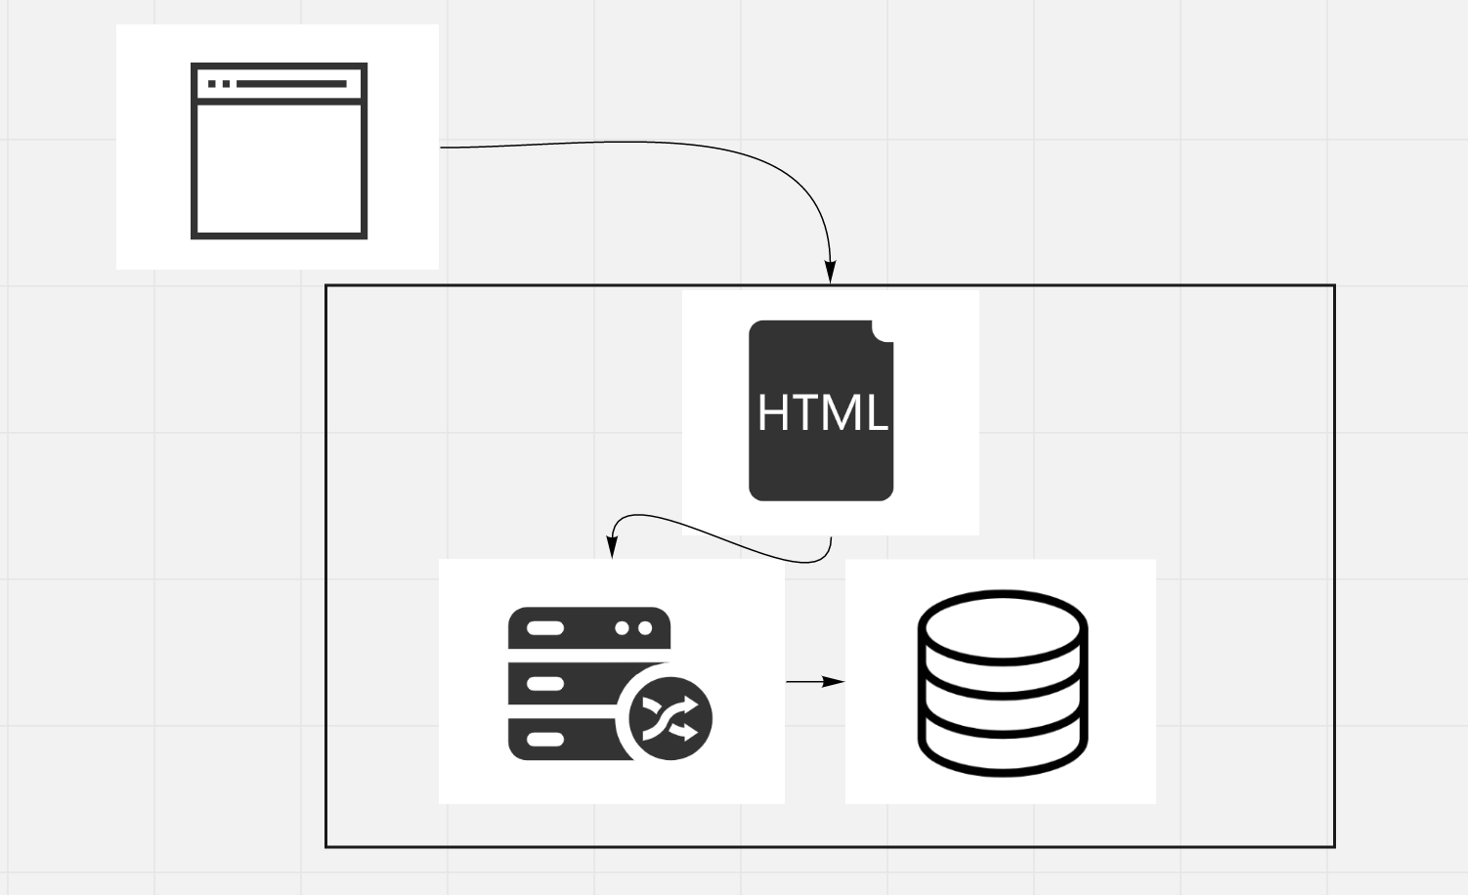
Todolist running on Ethereum
How does a web application work?
Introduction
Blockchain 1.0
Demonstration of 1.0
Blockchain 2.0
成果与运用
Blockchain 3.0
*
Notes:
The representative application of Blockchain 2.0 is Ethereum. And we made a todolist app on ethereum, It can show us how exactly the ethereum work.I will show it later on.
In order to understand how a blockchain application works, let's first look at how a todo list might work as a web application. To access the todo list, you would use a web browser that would communicate with a web server over the Internet. The server contains all of the code and data for the todo list.
We have:
● Client side files in HTML, CSS, and JavaScript
● Back end code responsible for the application's business logic
● Database that stores the tasks in the todo list
This server is a centralized entity . Anyone with full access to the server can change any part of the code or the data at any time.

Slide 12
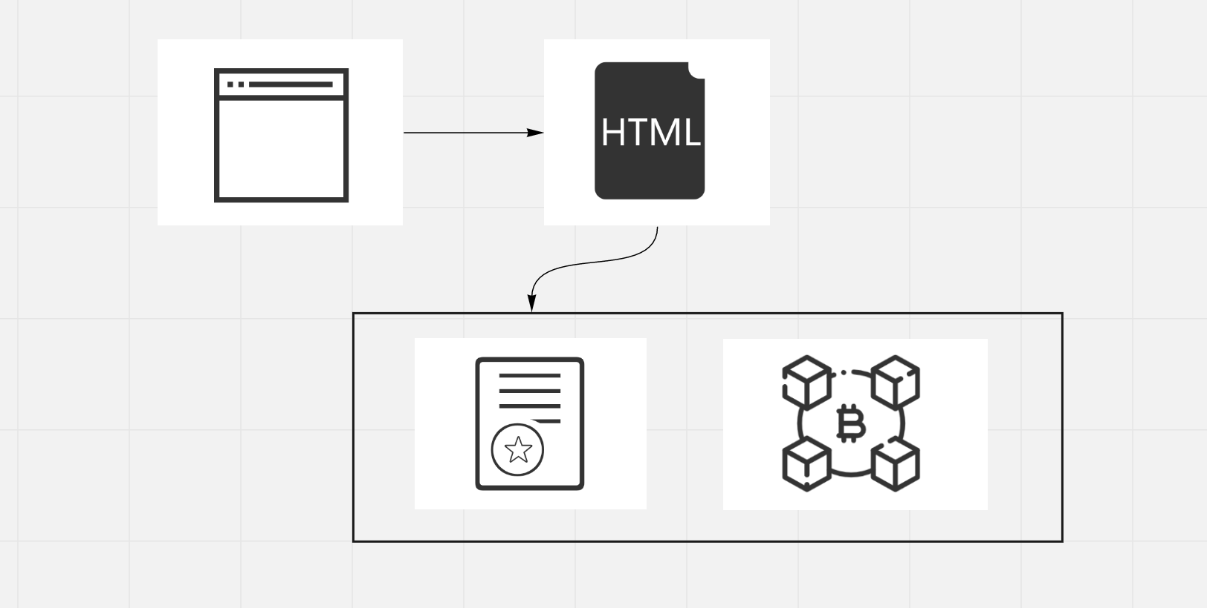
Todolist running on Ethereum
How does a blockchain application work?
Introduction
Blockchain 1.0
Demonstration of 1.0
Blockchain 2.0
成果与运用
Blockchain 3.0
Demonstration of 2.0
*
Notes:
A blockchain application works quite differently. All of the code and the data in the todo list does not lie on a centralized server. Instead, it is distributed across the blockchain. All of the code and the data is shared and unchangeable on the blockchain.
Instead of talking to a back end web server, the client side application will talk to the blockchain through smart contract.
Smart contract is written in a language called solidity, and in this project it is used to power our todo list. It will be responsible for fetching all of the tasks in our todo list from the blockchain, adding new tasks, and completing tasks.All of the code in the smart contract is immutable, or unchangeable,and that makes the data on blockchain very safe.

Slide 13
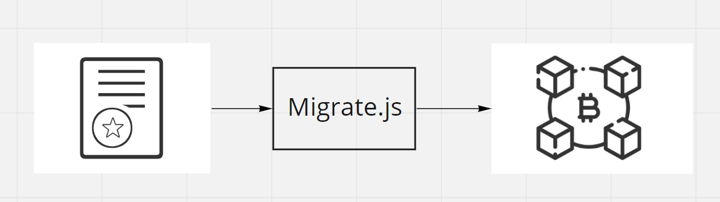
Todolist running on Ethereum
Migration Module
Introduction
Blockchain 1.0
Demonstration of 1.0
Blockchain 2.0
成果与运用
Blockchain 3.0
Demonstration of 2.0
*
Notes:
We also have a migration module, it acts like a middleware between smart contract and blockchain. When we are changing the blockchain, we are actually migrating it from one state to another. So that we need a migration module to help us update the blockchain.

Slide 14
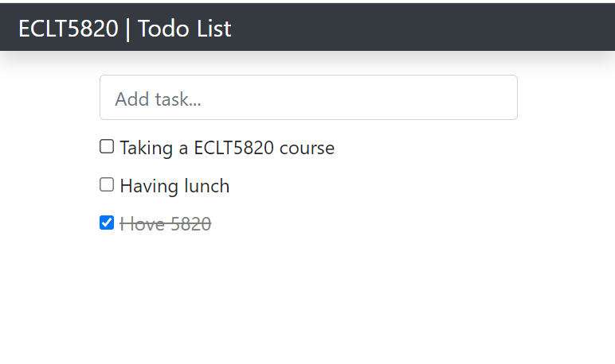
Todolist running on Ethereum
TodoList demo
Introduction
Blockchain 1.0
Demonstration of 1.0
Blockchain 2.0
成果与运用
Blockchain 3.0
Demonstration of 2.0
*
Notes:
The basic idea of our todolist app is that you can store and change data in the blockchain.

Slide 15
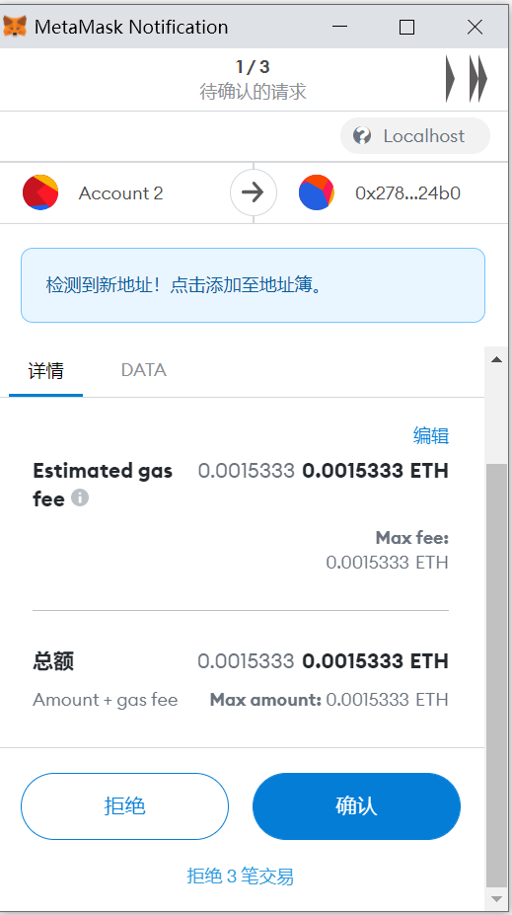
Todolist running on Ethereum
Confirm the transaction
Introduction
Blockchain 1.0
Demonstration of 1.0
Blockchain 2.0
成果与运用
Blockchain 3.0
Demonstration of 2.0
*
Notes:
You need to confirm and pay for each transaction by clicking the confirm button

Slide 16
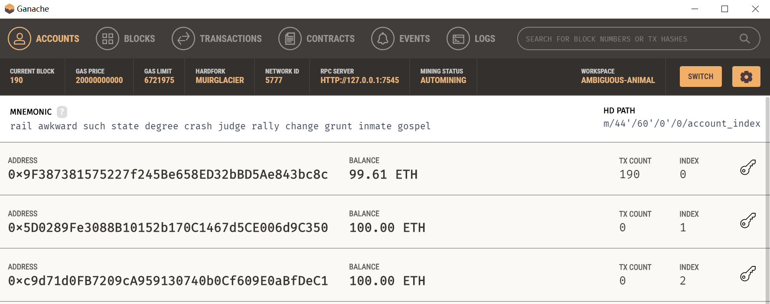
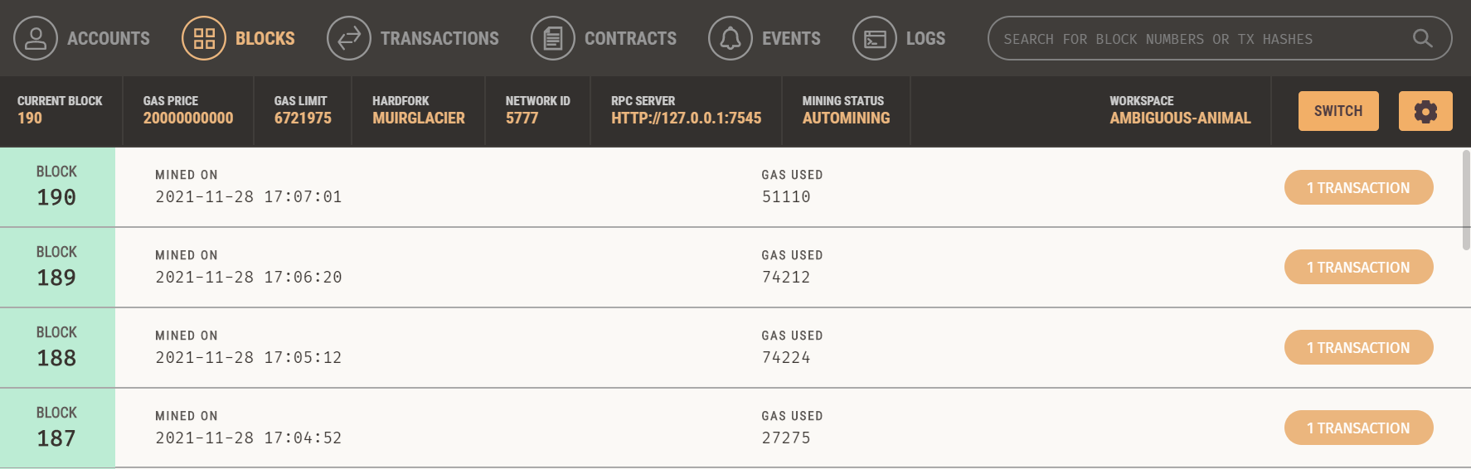
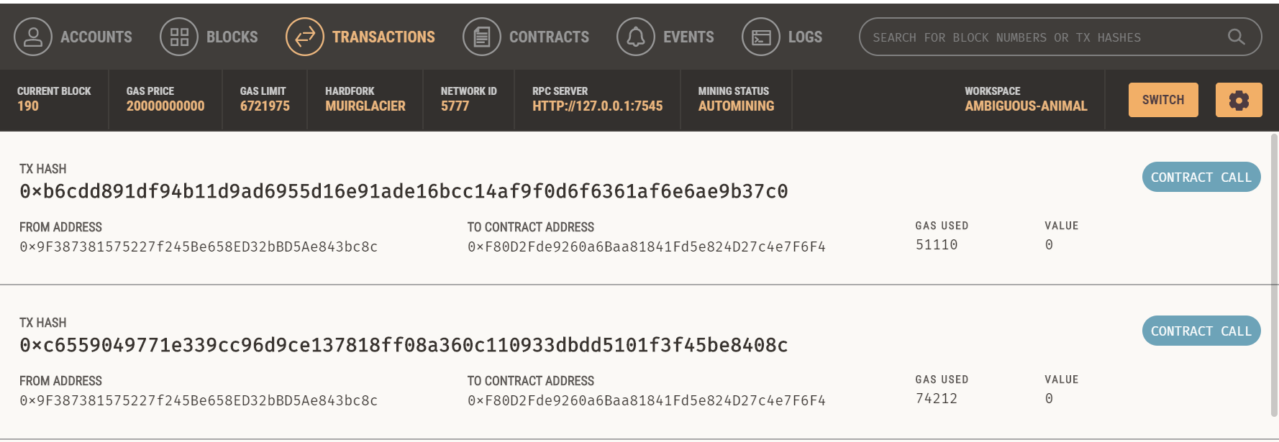
Todolist running on Ethereum
Check my account/blocks/transactions
Introduction
Blockchain 1.0
Demonstration of 1.0
Blockchain 2.0
成果与运用
Blockchain 3.0
Demonstration of 2.0
*
Notes:
After the transaction is commited, you can check the account，blocks and transactions.

Slide 17
Improvement of Blochain3.0
Main problem
Scalability issues —— Low throughput and high transaction latency
Lack Interoperability between distinct blockchains
Introduction
Blockchain 1.0
Demonstration of 1.0
Blockchain 2.0
Demonstration of 2.0
Blockchain 3.0
Blockchain 3.0
*
Notes:
Blockchain 3.0 is an upgraded version of blockchain 2.0, built to improve the technology's capabilities and solve the existing scalability problems, while facilitating speedier, cost-effective, and efficient transactions.

Slide 18
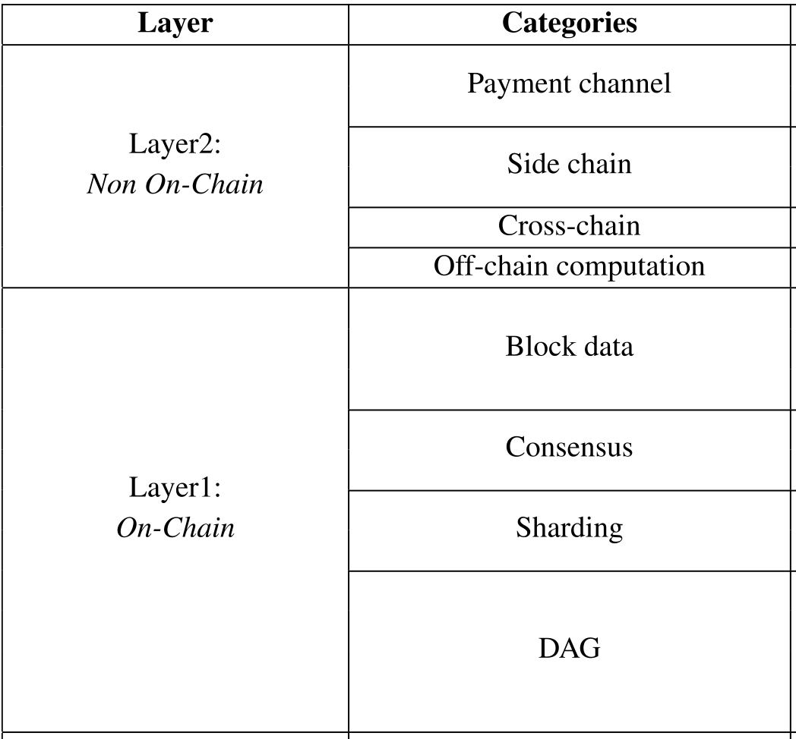
Improvement of Blochain3.0
Scalability issues
Introduction
Blockchain 1.0
Demonstration of 1.0
Blockchain 2.0
Demonstration of 2.0
Blockchain 3.0
Classify existing scaling solutions for blockchain by level [1]
Layer1 focuses on consensus, network and data structure of blockchain, all of which are executed on-chain.
Layer2 seeks the opportunity to scale out blockchain by off-chain methods such as off-chain, channel, side-chain and cross-chain protocols.
[1] Q. Zhou, H. Huang, Z. Zheng and J. Bian, "Solutions to Scalability of Blockchain: A Survey," in IEEE Access, vol. 8, pp. 16440-16455, 2020, doi: 10.1109/ACCESS.2020.2967218.
Blockchain 3.0
*
Notes:
For the scalability issues,
We classify existing scaling solutions for blockchain by level.
Here we mainly talk about the DAG, other will introduce in the final paper.

Slide 19
Improvement of Blochain3.0
Acyclic Graphs (DAGs)
Introduction
Blockchain 1.0
Demonstration of 1.0
Blockchain 2.0
Demonstration of 2.0
Blockchain 3.0
As the name implies, the information on a DAG-based network flows acyclically.
Such a structure eliminates the block times, which is 10 minutes for bitcoins and 20 seconds for Ethereum, thereby allowing transactions to get processed almost in real-time.
Blockchain 3.0
*
Notes:
One of the things that make blockchain 3.0 notable and viable is DAG (Directed Acyclic Graph) As the name implies, the information on a DAG-based network flows acyclically.
So, this means that the information cannot be sent back to the sender. The information will flow in only one direction. It makes sure that nodes are not connected to any previous ones. Such a structure eliminates the block times, which is 10 minutes for bitcoins and 20 seconds for Ethereum, thereby allowing transactions to get processed almost in real-time. DAG is being used by IoT chain (ITC) and it processes 10,000 transactions per second, which is far more than Visa.
The traditional blockchain stores transactions in blocks that are organized in a single chain structure. With this kind of structure, blocks cannot be generated concurrently and thus limits the transaction throughput. In order to solve this prob- lem, an idea dedicated to revising the structure of blockchain called DAG [86] is proposed.

Slide 20
Improvement of Blochain3.0
Interoperability
Introduction
Blockchain 1.0
Demonstration of 1.0
Blockchain 2.0
Demonstration of 2.0
Blockchain 3.0
Unfortunately, the industry is lacking an interoperability protocol to facilitate that communication.
Aion, Wanchain, and most recently, Polkadot are three prime examples of blockchain 3.0 projects specializing in interoperability.
The goal of these projects is to provide a mechanism for transferring data and assets between blockchains without needing a centralized third-party.
Blockchain 3.0
*
Notes:
With hundreds, possibly even thousands, of distinct blockchains, the ability to communicate between them is paramount. Unfortunately, the industry is lacking an interoperability protocol to facilitate that communication. Once again, numerous companies and projects are approaching this issue from all angles.
Aion, Wanchain, and most recently, Polkadot are three prime examples of blockchain 3.0 projects specializing in interoperability. The goal of these projects is to provide a mechanism for transferring data and assets between blockchains without needing a centralized third-party. So, you could exchange bitcoin for ether, for example, directly from one blockchain to the other.

